Slide 1
CSS Selectors
Tutorial #20

Slide 2
OBJECTIVE

Slide 3
Objective
After this tutorial, you should be able to break down your styling on a more individualized level using CSS selectors.

Slide 4
TEXTPLANATION

Slide 5
Textplanation
The number of HTML tags at your disposal is limited. It was always limited, but it has become more so with the introductions of HTML 4.01 and HTML 5. As CSS has almost entirely taken over all styling of a page, a lot of HTML tags have dropped off of the map entirely. That’s a necessary evolution and, really, no one’s going to miss the <marquee> tag.

Slide 6
Textplanation
Don’t use the <marquee> tag.

Slide 7
Textplanation
The problem with having a limited number of tags, is that you have a limited number of things you can redefine. You can start digging deep into your HTML toolbox and use the <b> tag and the <i> tag and every <h whatever> tag whenever you want to differentiate the way things look, but that will make your page pretty unruly.

Slide 8
Textplanation
I use a lot of <span>s and <div>s myself. They’re my favorites. So I need to be able to differentiate between them. Granted, I can assign them all Javascript variables and run my CSS through Javascript, but...no. I don’t need to do that. Instead, I can use CSS selectors.

Slide 9
Textplanation
A selector is a character that connects your CSS to an individualized tag.

Slide 10
Textplanation
For example, let’s say I want to make some of my <span>s red, but only the <spans>s that are inside, or the children of, <div>s. There’s a selector for that.
div span
{
color:red;
}

Slide 11
Textplanation
The space is the descendant selector. The previous coding example says that any <span> that is a descendant (child, grandchild, great grandchild, etc…) of a <div> will have red text. All other <span>s will be unaffected.

Slide 12
Textplanation
The descendant selector is just one of many selectors. We’ll look at a few of them during the Construction, but there are many more that we won’t really explore. You can look those up on w3schools.com.

Slide 13
CONSTRUCTION

Slide 14
Construction
There is a .zip file included with this tutorial. Inside are 3 folders. Please extract the candlestick folder. It contains the HTML file you’ll be using for this construction.
Create a .css file called cstick.css. You’ll use that file for the construction.
As you go through the images of the construction, add to your code. You will see comments with explanations of what you are doing. Those comments will change with each slide. You should not type my comments into your code.

Slide 15
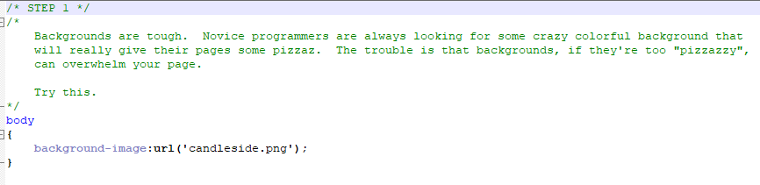
Construction

Slide 16
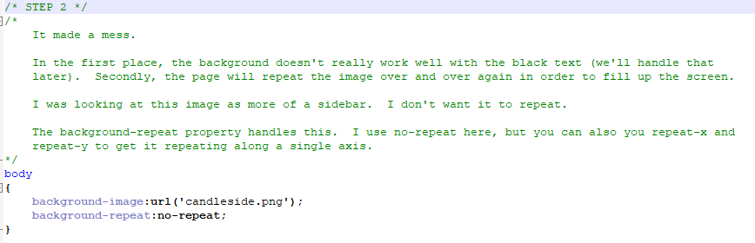
Construction

Slide 17
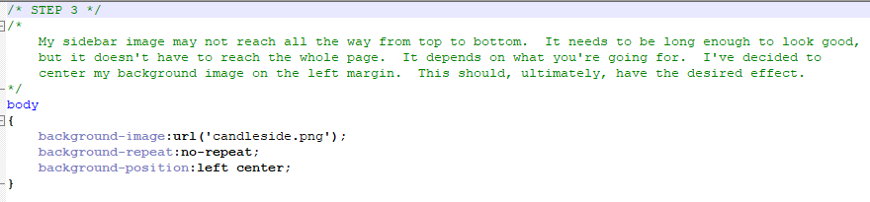
Construction

Slide 18
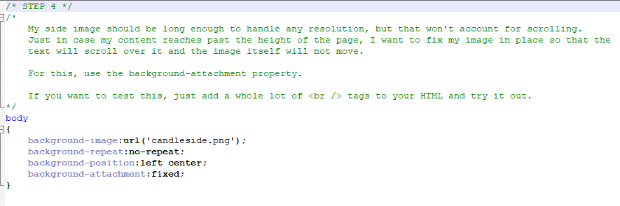
Construction

Slide 19
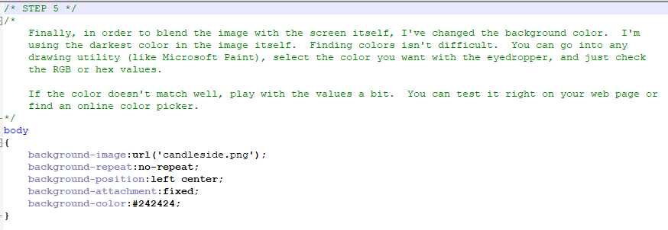
Construction

Slide 20
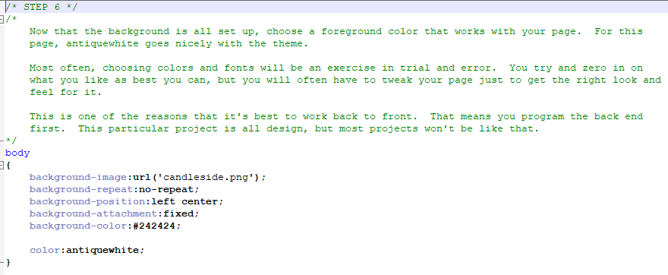
Construction

Slide 21
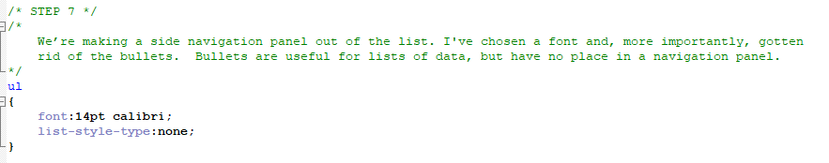
Construction

Slide 22
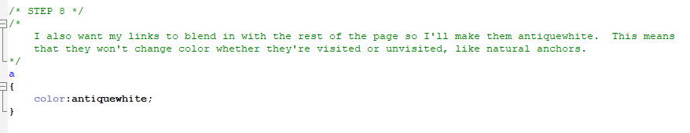
Construction

Slide 23
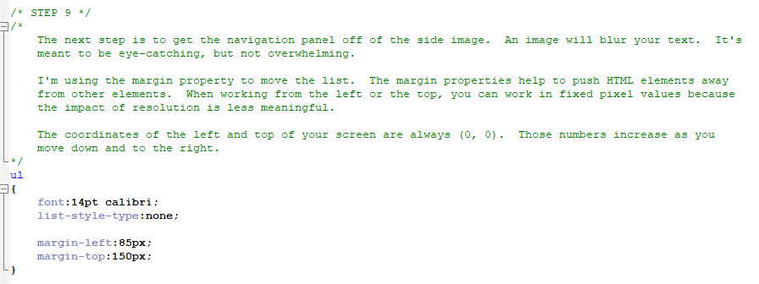
Construction

Slide 24
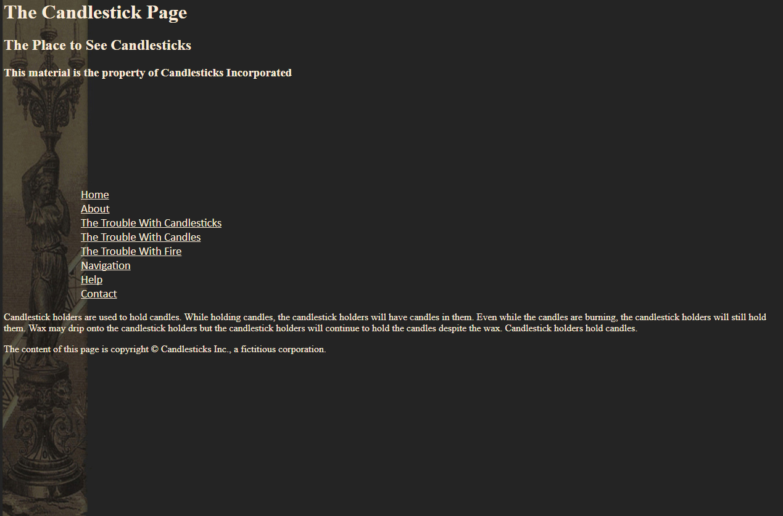
Construction
HTML Elements are laid out on the page according to a static flow. Each element’s position is dependent upon the position of the element before it.

Slide 25
Construction
There are no elements to the left of the list so it is 85px from the edge.
There is text above the list so its top is 175 pixels from the bottom of that text.
Margin changes the static position of the element in relation to the static position of the previous element so that the whole page is affected.
175 pixels
85 pixels

Slide 26
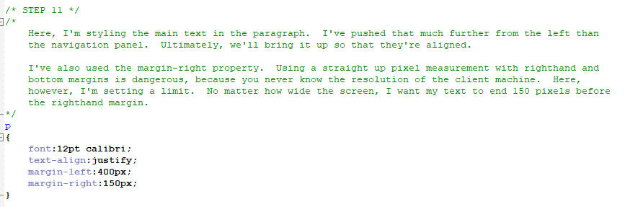
Construction

Slide 27
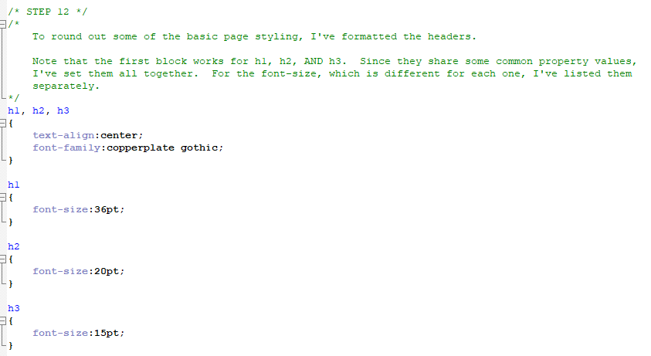
Construction

Slide 28
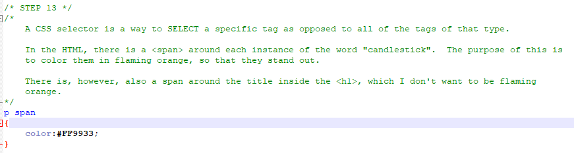
Construction

Slide 29
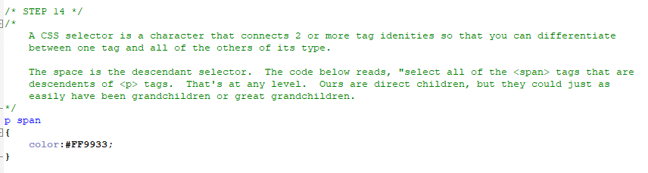
Construction

Slide 30
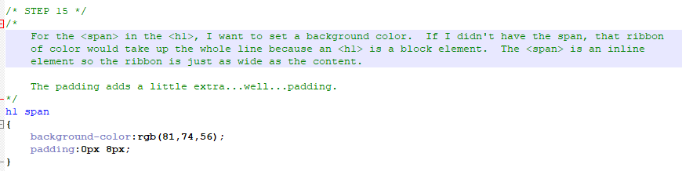
Construction

Slide 31
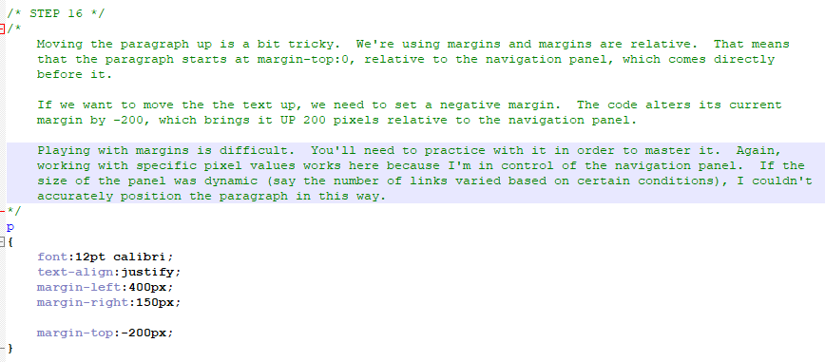
Construction

Slide 32
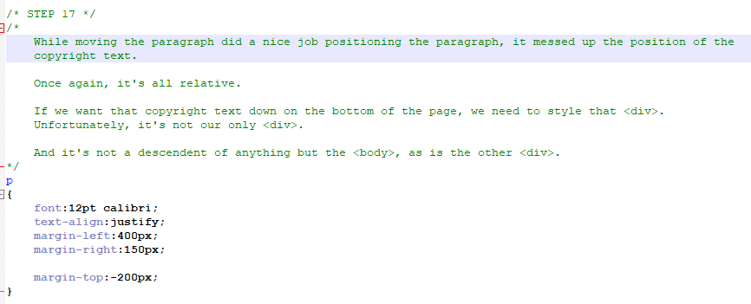
Construction

Slide 33
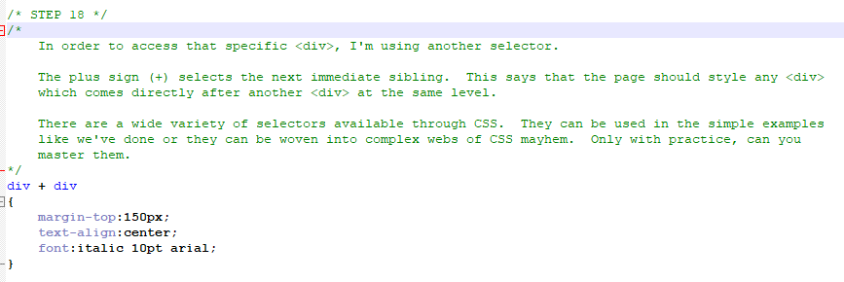
Construction

Slide 34
A DEEPER MEANING

Slide 35
A Deeper Meaning
CSS selectors are great, and really useful to a point. They add a depth to CSS that it didn’t really seem to have before. In the next tutorial, we’ll look at classes, which is kind of the ultimate CSS selector. Classes give us complete autonomy regarding the individualizing of CSS definitions.

Slide 36
A Deeper Meaning
JQuery, a utility built from Javascript for designing web pages, makes use of CSS and CSS selectors. It creates an environment where manipulating the HTML elements on a page is simple and eloquent. There are several of these types of utilities in existence. I recommend that you be aware of them but avoid using them in your code until you fully understand Javascript and CSS.

Slide 37
FAQ

Slide 38
FAQ
Question?
Answer.

Slide 39
ACTIVITY

Slide 40
Mimic
Included with this tutorial is a .zip file with 3 folders in it. You used one of the folders for the construction. The other two folders contain images relevant to this activity. You will choose just one of the folders and work from that.
Each of the folders contains something with “site screenshot” in the name. This image shows what your web page should look like after you are finished coding it.
Write a full HTML/CSS page that looks as close to the screenshot as possible (do not simply put the screenshot image onto your page...nice try).
You do not have the font or color information so just use an approximation. Choose a font that is close and that looks code. The same goes for the colors.

